Slide 1
Crop Recommendation
Prachi Khatri(N01578832)
Jasmeet Kaur (N01636328)
AIGC-5000-0NA Humber College

Slide 2
Problem Statement
Farmers are looking for more educated ways to make decisions to maximize farming techniques in the era of precision agriculture. The objective is to create a predictive model that suggests the best crops to grow on a certain farm to meet this need. The advice is based on important factors like temperature, humidity, soil pH, rainfall, and the ratio of nitrogen (N), phosphorus (P), and potassium (K) content in the soil. The goal is to enable farmers with exact insights so they can make customized crop selection selections by utilizing machine learning. By improving the accuracy of recommendations, this predictive model seeks to transform agricultural practices and ultimately increase crop growth, livestock welfare, and overall farm output.

Slide 3
Dataset Description
The dataset includes characteristics that are essential in assessing whether a crop is suitable for production. The following fields are included:
1. N (Nitrogen): Ratio of Nitrogen content in the soil.
2. P (Phosphorous): Ratio of Phosphorous content in the soil.
3. K (Potassium): Ratio of Potassium content in the soil.
4. Temperature: The temperature recorded in degrees Celsius.
5. Humidity: Relative humidity measured in percentage.
6. pH: The pH value indicating the acidity or alkalinity of the soil.
7. Rainfall: Amount of rainfall measured in millimeters.

Slide 4
Statistical plots of the dataset (e.g. bivariate analysis).

Slide 5
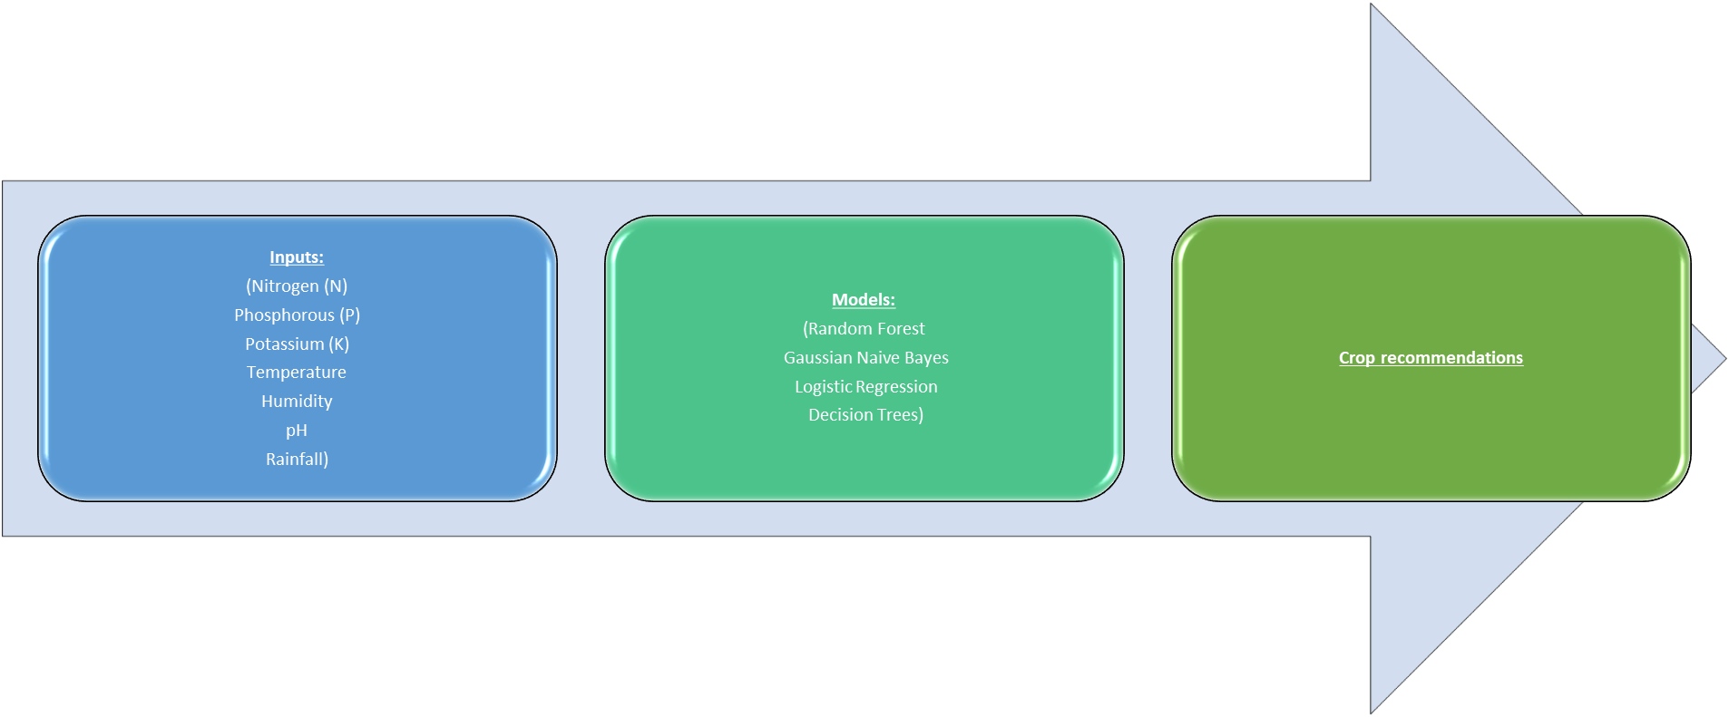
Analytical/Predictive model Diagram:
The inputs (agricultural parameters) are fed into the selected machine learning models.
The models analyse and learn from the input data to establish relationships between various factors and crop outcomes.
The trained models then predict the most suitable crops based on new input data.
The output provides crop recommendations, aiding farmers in making informed decisions.

Slide 6
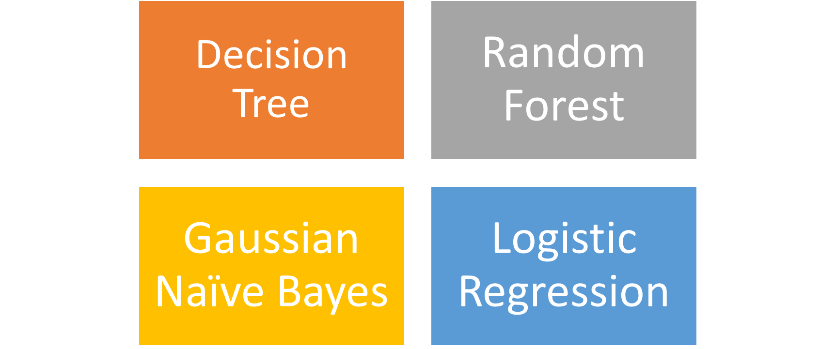
Predictive Models:

Slide 7
Proposed Analytical/Predictive Model
The model's design addresses the problem of helping farmers choose the best crops for precision farming by integrating an extensive dataset that includes important agricultural variables. By utilizing classification methods such as Gaussian Naive Bayes, Random Forest, Logistic Regression, and Decision Trees, the model discerns complex patterns within the data, thereby enabling precise crop suggestions. Although Logistic Regression is accurate, it performs less consistently than ensemble approaches; Random Forest is excellent at handling complex relationships; and Gaussian Naive Bayes shows consistent performance. In the era of precision agriculture, this model gives farmers a flexible tool to improve decision-making and optimize farming operations.

Slide 8
Results and Discussion
Visualization of analytical and inference results.

Slide 9
Proposed Analytical/Predictive Model
Discuss what you can infer from the visualizations.

Slide 10
Conclusion
Random Forest and Gaussian Naive Bayes emerge as superior algorithms for crop recommendation, boasting remarkable accuracy (99.45% and 99.64% respectively).
Random Forest excels in handling complex data relationships, outperforming Logistic Regression and Decision Trees.
These findings emphasize the efficacy of probabilistic models and ensemble techniques, particularly Random Forest, in crop recommendation applications.

